Slide 1
CHURN CASE
AB testing
Customer Segmentation
Decision Tree
Logistic Regression
Model Evaluation
Customer Lifetime Value
Rui Li
https://github.com/ruili629/MarketingAnalyticsAssignment
2020/5/15

Slide 2
Prepocessing
0
https://github.com/ruili629/MarketingAnalyticsAssignment

Slide 3
Drop some cols or rows
Reason:
1. One single value (Language, Country)
2. Abnormal value (Leave only those age<100 or eg. change 1997 into 2020 - 1997 = 23)
3. Uncontrollable or usless factor in segmentation (eg. subid)

Slide 4
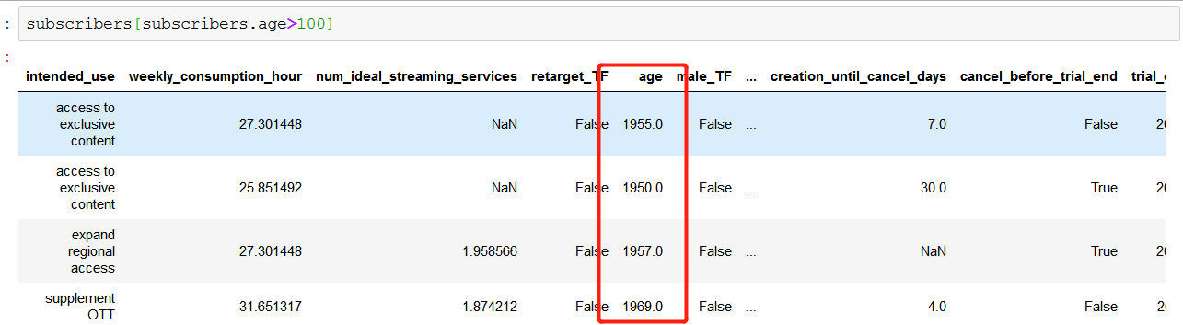
Age
# change those > 1900 to 2020 - year

Slide 5
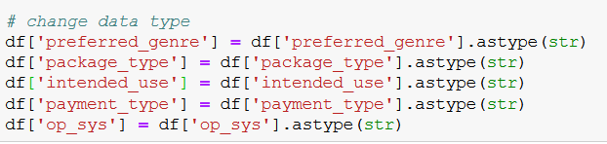
Fill in the NA
Change Data Type

Slide 6
AB Testing
1
单击此处添加副标题内容

Slide 7
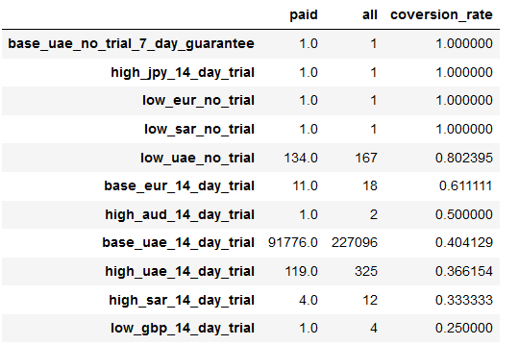
AB Testing - paid
**Hypothesis setup:**
Variant B: high_uae_14_day_trial
Variant A: base_uae_14_day_trial
H0: Variant B and Variant A had the same conversion rates.
HA: Variant B had a lower conversion rate than Variant A
**Assumptions:**
Variant A represents the population and we can treat the population mean as known and equal to the mean of Variant A.
Result:
|Z| = 2.2 > 1.64
Notes:
With 95% confidence level, 𝑍0.05 = 1.64. Reject null if z > 1.64. Since z is 2.2, we reject the null hypothesis and conclude that at 95% confidence level, variant B generates less conversion than variant A.

Slide 8
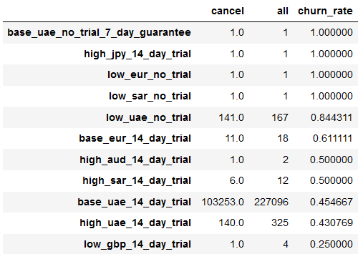
AB Testing - cancel_before_trial_end
**Hypothesis setup:**
Variant B: high_uae_14_day_trial
Variant A: base_uae_14_day_trial
H0: Variant B and Variant A had the same churn(cancel) rates.
HA: Variant B had a lower churn rate than Variant A
**Assumptions:**
Variant A represents the population and we can treat the population mean as known and equal to the mean of Variant A.
Result:
|Z| = 12.22 > 1.64
Notes:
With 95% confidence level, 𝑍0.05 = 1.64. Reject null if z > 1.64. Since z is 12.22, we reject the null hypothesis and conclude that at 95% confidence level, variant B generates less churn than variant A.
comment: large sample, assume one population, paired sample or is it not, stating the assumption,

Slide 9
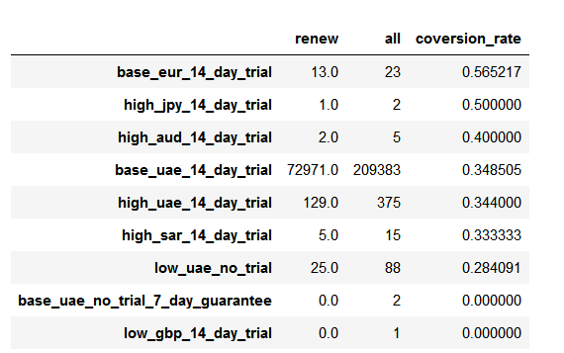
AB Testing - renew
**Hypothesis setup:**
Variant B: high_uae_14_day_trial
Variant A: base_uae_14_day_trial
H0: Variant B and Variant A had the same renew rates.
HA: Variant B had a lower renew rate than Variant A
**Assumptions:**
Variant A represents the population and we can treat the population mean as known and equal to the mean of Variant A.
Result:
|Z| = 9.71 > 1.64
Notes:
With 95% confidence level, 𝑍0.05 = 1.64. Reject null if z > 1.64. Since |z| is 9.71, we reject the null hypothesis and conclude that at 95% confidence level, variant B generates less conversion than variant A.

Slide 10
Optimal Sample Size and Sequential Testing - (paid)
The optimal sample size for each segment is 2616
The challenger wins 0.0% of the time.
Assume P(Xi=1) under H0 = p-varA and P(Xi=1) under H1 = p-treatment.
Set desired type 1 error = 5% and type 2 error = 20%.
Success rate is 80.0%

Slide 11
Customer Segmentation
2
单击此处添加副标题内容

Slide 12
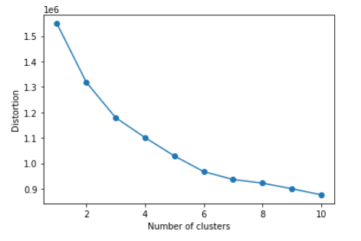
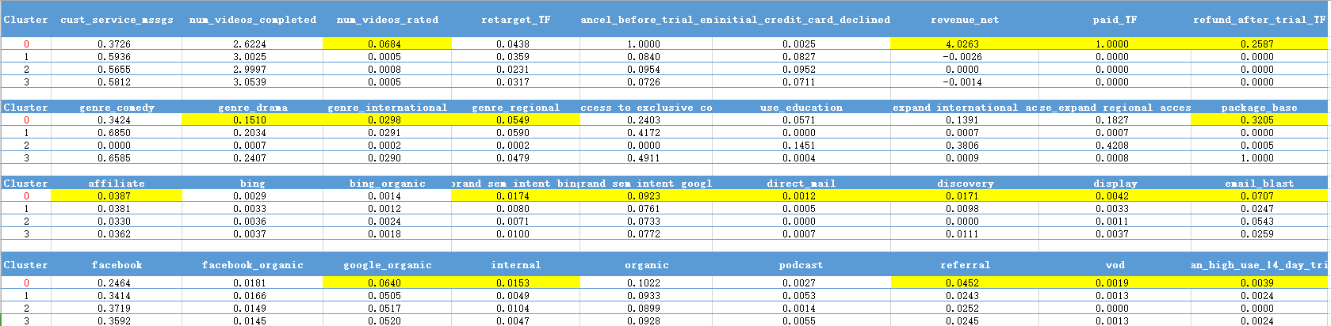
Customer segmentation
Cluster 0 (High value) customer description:
1. They completed less videos but they rated much more often.
2. Customer internet package: base mainly.
3. Preferred genre: comedy and drama mainly.
4. Main Attribution_technical_brand: “sem intent google”, ”email blast” .
5. Plan_type: high_uae_14_day_trial
6. Main Payment_type:Paypal
7. Main Payment_type_Standard:Charter
8. High Value becasue they pay.

Slide 13
Decision Tree
3
Preprocess our input DF
Feature Selection
Process
Visualization

Slide 14
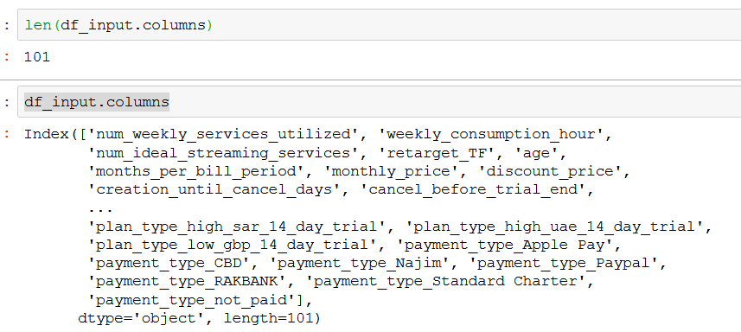
Which features to select?
After we finish the cleaning data and use get dummies to get our input dataframe, we get a problem:
Too many variables!
Recursive Feature Ranking with recursive feature elimination and cross-validation
We choose to use the RFECV, which performs RFE in a cross-validation loop to find the optimal number or the best number of features. Hereafter a recursive feature elimination applied on decision tree classifier or logistic regression with automatic tuning of the number of features selected with cross-validation.
Classifier: decision tree; Dependent variable: renew;

Slide 15
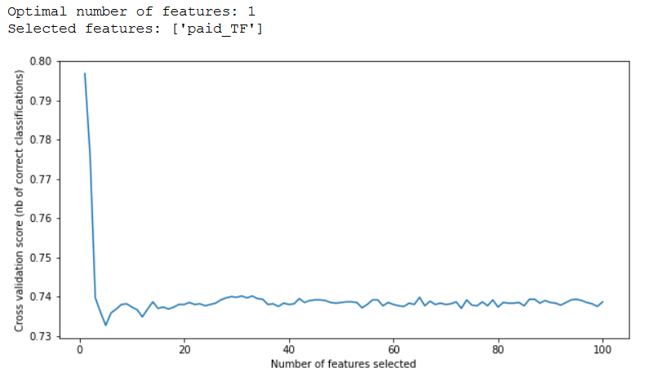
Apply it right away?
If we apply the RFECV without further
preprocessing, we would get:
Optimal number of features: 1
Selected features: ['paid_TF']
This is not satisfying since paid_TF is only a
a result and it is highly correlated with “renew”

Slide 16
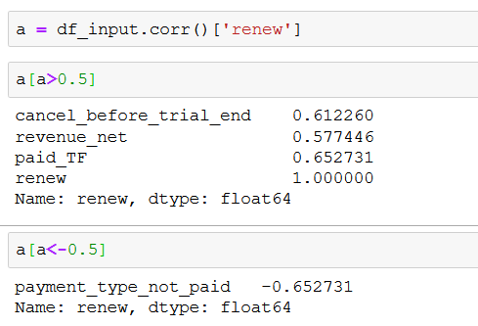
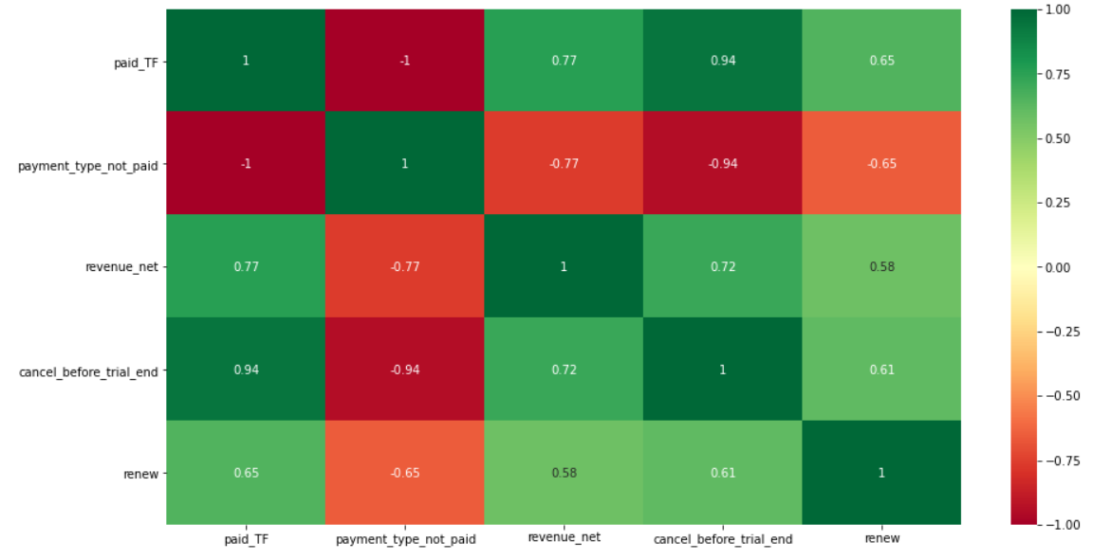
Drop those “result” variable
Dropping the variables that are highly correlated with “renew”:
['paid_TF','payment_type_not_paid','revenue_net','cancel_before_trial_end','renew']

Slide 17
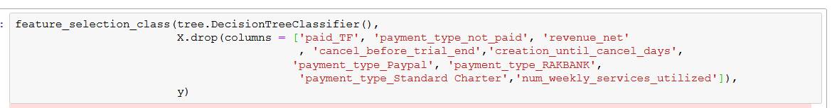
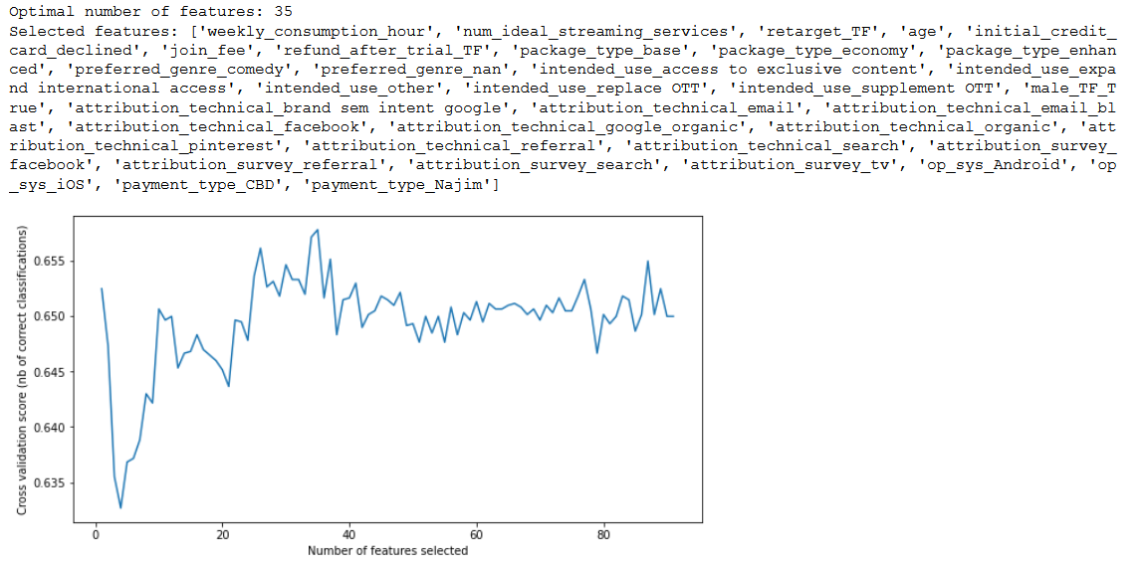
After dropping the highly correlated 'result-type'variables like cancel, revenue_net, we ran the RFECV again to get the best number and types of features.
点击输入正文

Slide 18
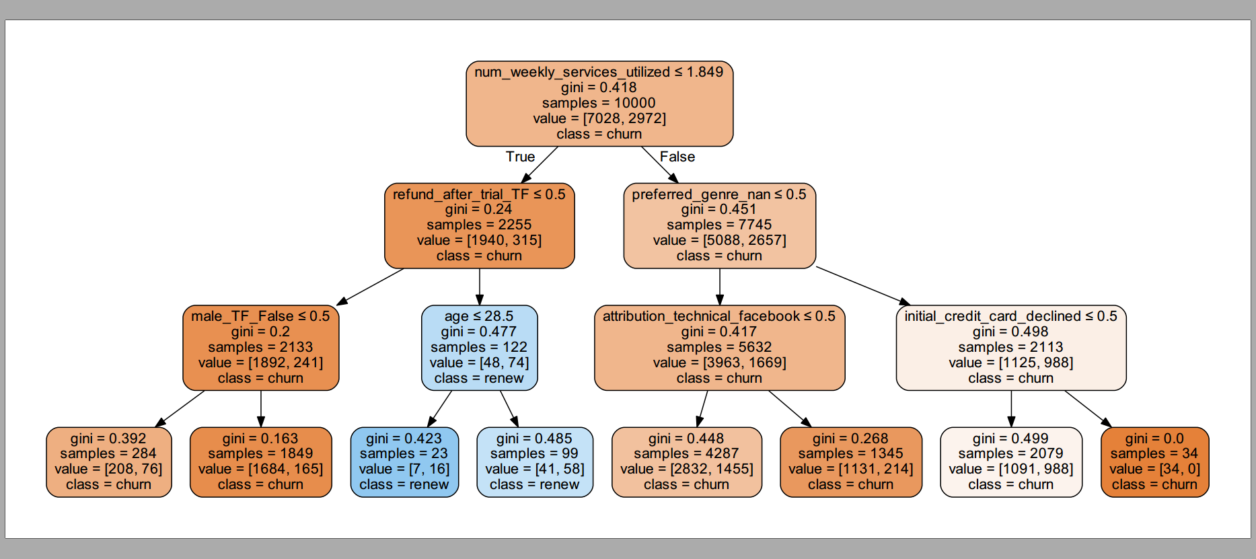
To better visualize the tree, I used the max depth =3, yet the best depth tested for now is 10
Decision Tree
Max depth = 3

Slide 19
Model Evaluation
4
1.Under the same process of building decision tree, the logistic regression was also built
2.Comparing the result of Logistic Regression

Slide 20
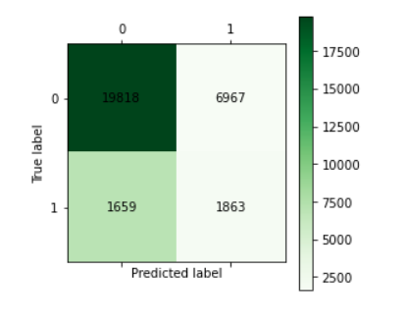
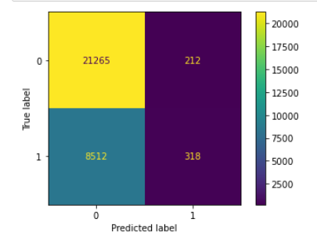
Confusion Matrix
Comparing Confusion Matrix of two models, Logistic Regression model has a higher true positive rate but als higher false negative rate.
Decision Tree
Logistic Regression

Slide 21
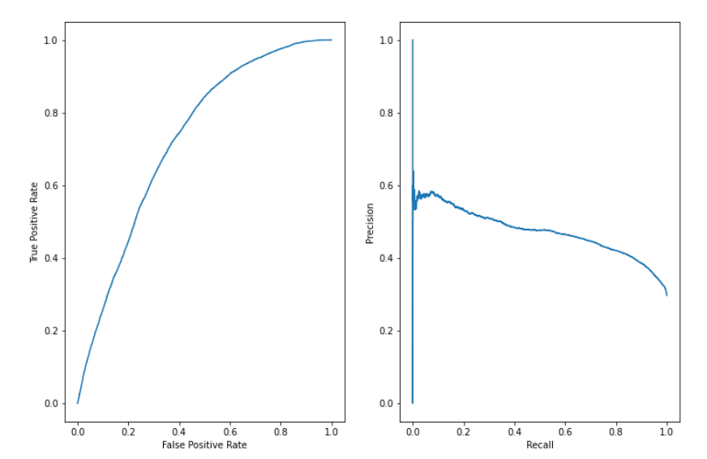
Confusion Matrix
Since it seems that the logistic regression has a bit better performance than decision tree, and the result of its recall and precision is just satisfying.

Slide 22
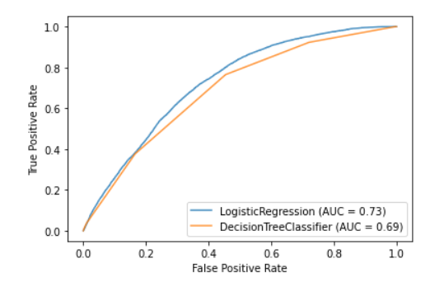
ROC Curve
From the ROC curve, it appears that the logistic regression has a bit better performance

Slide 23
Customer Lifetime Value
5
Using logistic regression to predict

Slide 24
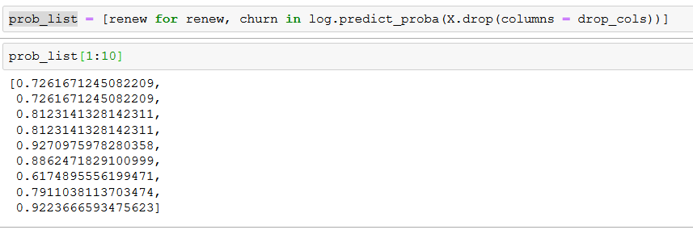
CLV caculation
As it appears that the logistic regression has a bit better performance, we shall use the logistic model to predict how likely this customer is sill going to renew in the nex period, so as to simulate and get the lifetime value.

Slide 25
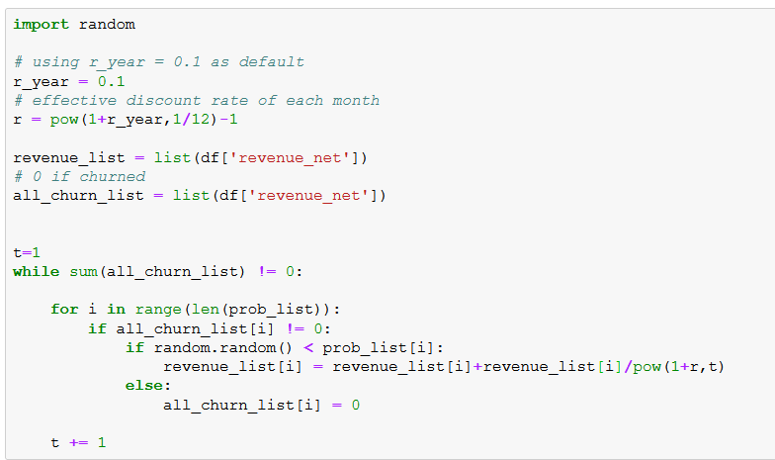
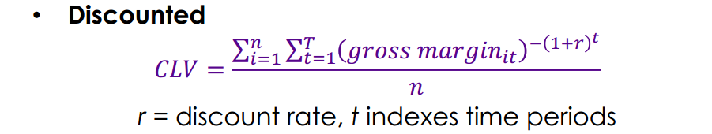
CLV Caculation Method

